Slide 1
Object Oriented Programming Week-2 Feb 7-11, 2022
Instructor:
Abdul Aziz
Assistant Professor
(Software Engg. Department)
National University- FAST (KHI Campus)

Slide 2
acknowledgment
- Publish material by Virtual University of Pakistan.
- Publish material by Deitel & Deitel.
- Publish material by Robert Lafore.

Slide 3
Programming Paradigms
1- Sequential
2- Procedural
3- Object Oriented

Slide 4
Programming Paradigms
Data Oriented
Process Oriented
Object Oriented
Think in term of data that we needed
Think in term of Process that we needed
Think in term of Object that is involved

Slide 5
What is object orientation
- A technique for system modeling.
- OO model consists of several interacting objects.

Slide 6
What is a Model?
- abstraction of something.
- Purpose is to understand the product before developing it.

Slide 7
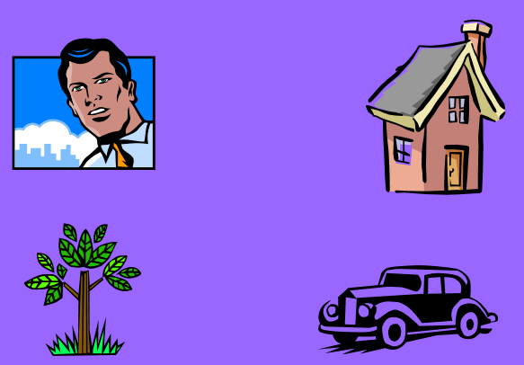
Example – OO Model

Slide 8
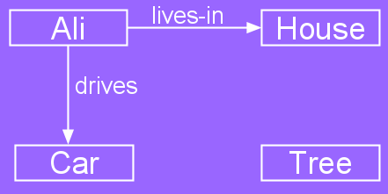
Example – OO Model
Objects
Person i.e Name: Ali
House
Car
Tree
Interactions
Ali lives in the house
Ali drives the car

Slide 9
Object-Orientation - Advantages
- People think in terms of objects
- OO models map to reality
Therefore, OO models are:
- easy to develop
- easy to understand

Slide 10
Five principles of OO paradigm
1- Abstraction: To have the relevant information.
2- Encapsulation: To hide information inside the object.
3- Polymorphism: To have many shapes / behaviors.
4- Inheritance: To create a new object with an existing one (To adopt features from others)
5- Reusability: Ability to use an object again and again if needed.

Slide 11
What is an Object?
An object is:
- It can be anything for which we want to save Information
- Something tangible (Ali, Car)
- Something that can be captured intellectually (Time, date)
An object has:
State / attributes / properties / data
Well-defined behavior / methods / functions
Unique identity

Slide 12
Ali as an object
Attributes:
Name
age
Behavior (operations)
Walks
Eats
Identity
His name

Slide 13
Car as an Object
State (attributes)
Color
Model
Behavior (operations)
Accelerate
Start Car
Change Gear
Identity
Its registration number

Slide 14
Visualizing an Object
Functions/Methods/Behavior
Objects Data / Attributes / States

Slide 15
Object
Technical Definition:
- “An Object is an Instance of a class”
- “An Object is the implementation of a class”
In general we say :
“ Any tangible thing for which we want to save Information”
Now onwards we treat object technically.

Slide 16
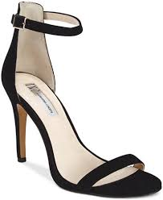
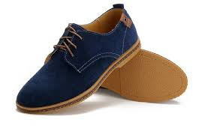
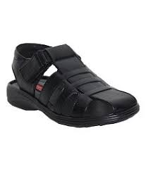
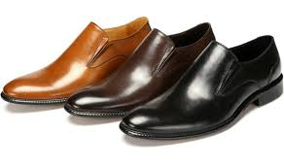
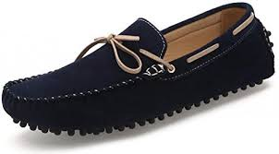
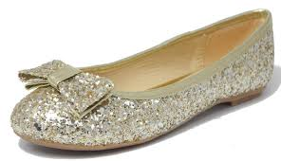
Some Examples
SHOES
Female sandal
Casuals
Men sandal
Formal
Loafers
Pumpies

Slide 17





Humans

Slide 18


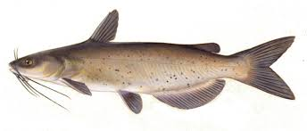
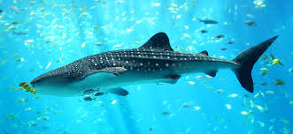
FISH

Slide 19
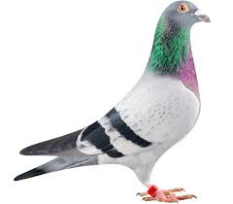
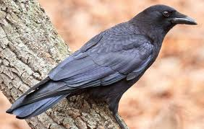

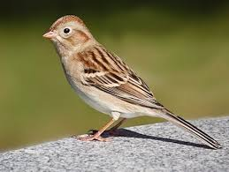
BIRD

Slide 20


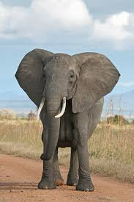
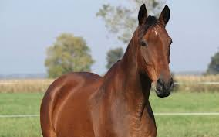
Animal

Slide 21
Discussion
- Object belongs to a group.
- Which similar.
- Have some common attributes.
- Have some common behaviors.
- We can categorized objects on some basic features …. ?

Slide 22
Class
- Collection of Similar object.
- The objects that share some common features.
- It is the a design of an object.
- It is a detail of an object.
- It tell us what an object contains in it.
Technical Definition:
“ A class is blueprint of an object”

Slide 23
Summarize
A class :
It’s a blue print .
It’s a design or template.
An Object:
Its an instance of a class.
Implementation of a class.
NOTE: Classes are invisible, object are visible

Slide 24
Generalized Class
- The class that only exhibits the common features of its objects.
Examples:
- ANIMAL
- BIRDS
- HUMAN
- No object of generalized class is found.

Slide 25
Specialized Class
- The class that exhibits different or unique features (behaviors)
ANIMAL (Generalized)
Specialized:
Mammals
Cats
Dog
ANIMAL
WILD PET
CAT CAT
Lion Streat Cat Persian Siamese

Slide 26
Type of classes
1- Abstract Class: The classes we make against abstract concepts are called abstract classes. Abstract Classes can not exist standalone.
2- Concrete Class: The entities that actually we see in our real world are called concrete objects and classes made against these objects are called concrete classes.
3- Sub-type: Sub-typing means that derived class is behaviorally compatible with the base class. Also known as Extension.
4- Specialized class: Specialization means that derived class is behaviorally incompatible with the base class

Slide 27
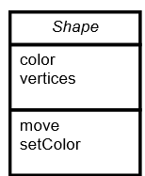
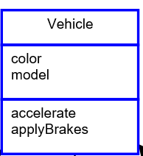
Abstract Class

Slide 28
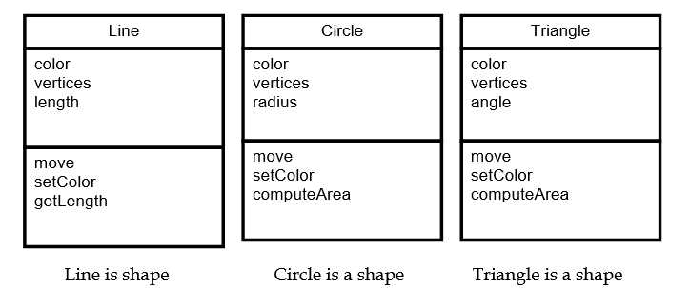
Concrete Class

Slide 29


Class Activity
5- Pen
3- Parents
4- Playground
2- Classroom
0/1- Library
6- Book
7- Bag
8- Student
9 Teacher

Slide 30
Questions
1- Identify at least 3 behaviors and related data for an object.
2- Draw an object interaction model based on the objects .

Slide 31
Solution
Teaches
Student
Plays-in
Playground
Teacher
Has
Book
Pen
School Bag

